Slide 1
JBOSS EAP - CLI

Slide 2
Commands
Connect
Deploy “fullnameandpath.ear”
Undeploy nameofthejar.jar
deployment-info
:take-snapshot()
:list-snapshots()
:shutdown(restart=true)
deploy “fullnameandpath.ear" --server-groups=main-server-group
deployment-info --server-group=main-server-group
/host=master/server-config=server-one:stop

Slide 3
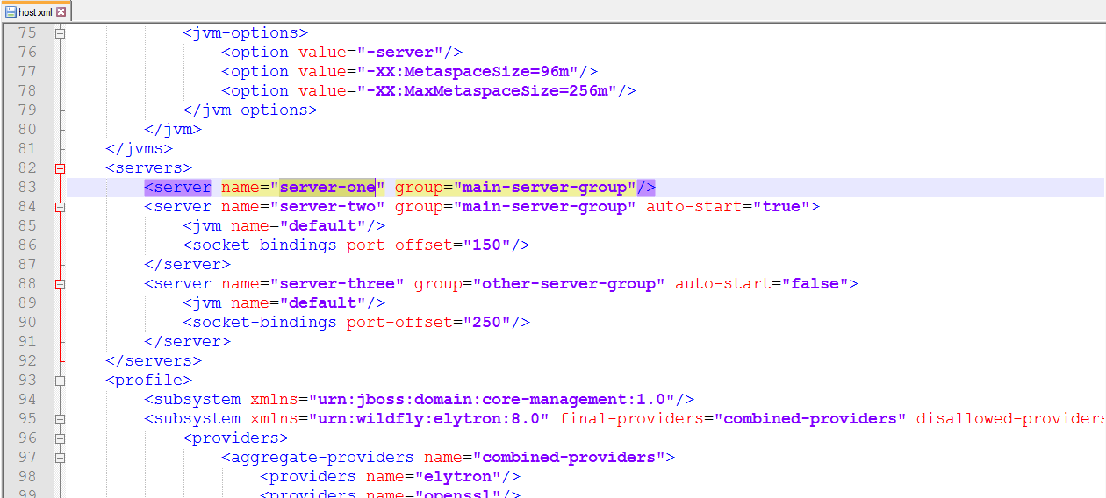

Slide 4
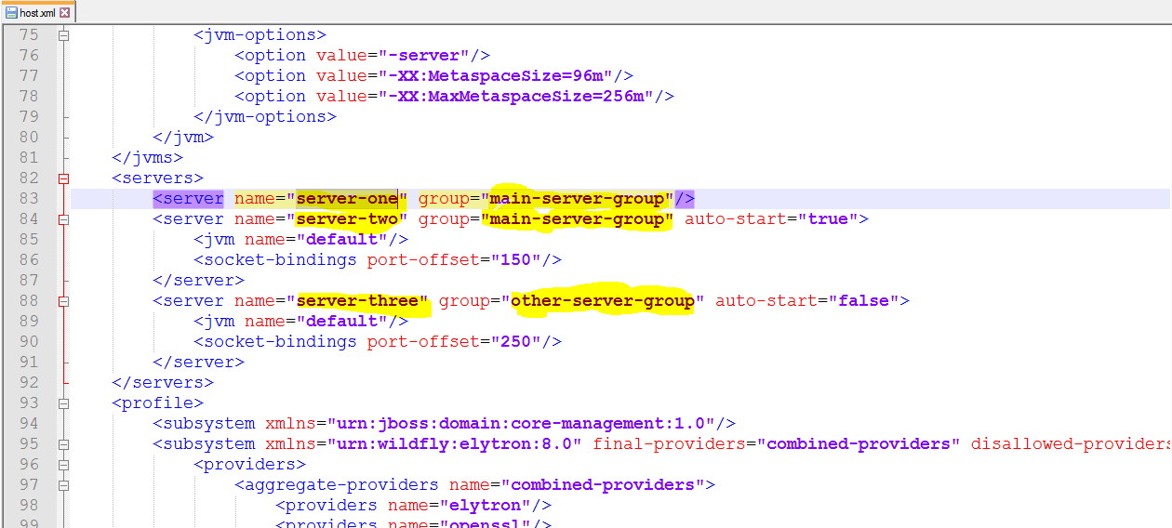

Slide 5
